Slide 1

DIGITAL ELECTRONICS
III Semester ECE
Dr. Ranjita Rout
DEPARTMENT OF ELECTRONICS AND COMMUNICATION ENGINEERING
SCHOOL OF ENGINEERING & TECHNOLOGY
GIET UNIVERSITY, GUNUPUR, ODISHA

Slide 2
Synchronous Sequential Logic
Sequential Circuits;
Latches, Flip-Flops;
Master-Slave Flip-Flop

Slide 3
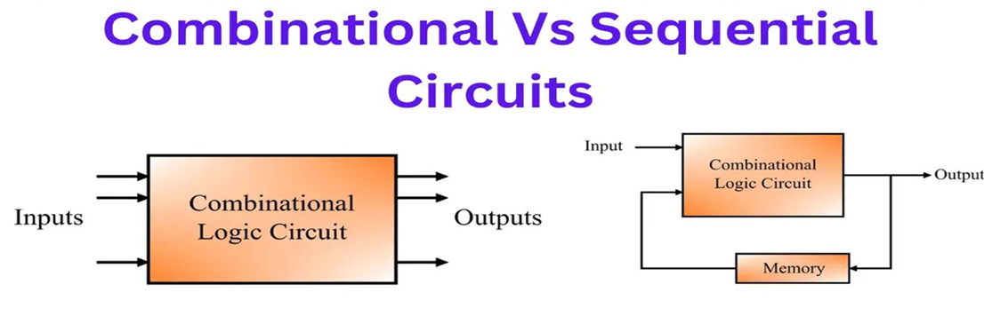
SEQUENTIAL CIRCUITS
Digital circuits are classified into two major categories namely, combinational circuits and sequential circuits.

Slide 4
What is a Sequential Circuit?
A sequential circuit is a logic circuit that consists of a memory element to store history of past operation of the circuit.
Therefore, the output of a sequential circuit depends on present inputs as well as past outputs of the circuit.
Here, it can be seen that a sequential circuit is basically a combination of a combinational circuit and a memory element.
The combinational circuit performs the logical operations specified, while the memory element records the history of operation of the circuit. This history is then used to perform various logical operations in future.

Slide 5
In sequential circuits, the memory element is another crucial component that holds the history of circuit operation.
Generally, flip-flops are used as the memory element in sequential circuits.
In sequential circuits, a feedback path is provided between the output and the input that transfers information from output end to the memory element and from memory element to the input end.
All these components are interconnected together to design a sequential circuit that can perform complex operations and store state information in the memory element.

Slide 6
Difference between Combinational and Sequential Circuits
Combinational Circuit
Sequential Circuit
A circuit output depends upon the present inputs as well as past history of the inputs.
These circuits have memory element.
There exists a feedback path between input and output.
This is time dependent.
It may or may not clock signal but most sequential circuit have a clock signal.
Elementary building blocks: Flip-flops.
A circuit whose output depends only upon the present inputs.
These circuits do not have any memory element.
There is no feedback between input and output.
This is time independent.
It does not have clock signal.
Elementary building blocks: Logic gates.

Slide 7
Combinational Circuit
Sequential Circuit
Used for arithmetic as well as Boolean operations.
Speed is fast.
It is designed easy.
It is easy to use and handle.
Examples - Encoder, Décoder, Multiplexer, De-multiplexer.
Mainly used for storing data.
Speed is slow.
It is designed tough as compared to combinational circuits.
It is not easy to use and handle.
Examples - Flip-flops, Counters, Shift registers.

Slide 8
Types of Sequential Circuits
Based on structure, operation, and applications, the sequential circuits are classified into the following two types −
Synchronous Sequential Circuit
Asynchronous Sequential Circuit

Slide 9
Synchronous Sequential Circuit
A synchronous sequential circuit is a type of sequential circuit in which all the memory elements are synchronized by a common clock signal.
Hence, synchronous sequential circuits take a clock signal along with input signals.
Synchronous sequential circuits that use clock pulses in the inputs of memory elements are called clocked sequential circuits.

Slide 10
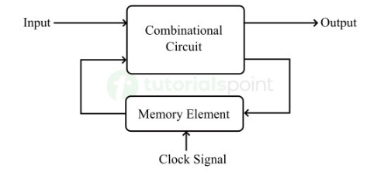
In synchronous sequential circuits, the duration of the output pulse is equivalent to the duration of the clock pulse applied.
Fig. Block diagram of a synchronous sequential circuit.
In this figure, it can be seen that the memory element of the sequential circuit is synchronized by a clock signal.

Slide 11
The major disadvantage of the synchronous sequential circuits is that their operation is quite slow.
This is because, every time the circuit has to wait for a clock pulse for the operation to take place.
However, the most significant advantage of synchronous sequential circuits is that they have a reliable and predictable operation.
Examples of synchronous sequential circuits include counters, registers, memory units, control units, etc.

Slide 12
Asynchrnous Sequential Circuit
A type of sequential circuit whose operation does not depend on the clock signals is known as an asynchronous sequential circuit.
The main components of the asynchronous sequential circuits include un-clocked flip flops and combinational logic circuits.

Slide 13
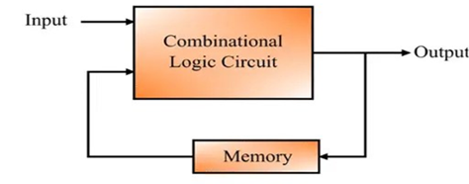
Fig. Block diagram of an asynchronous sequential circuit

Slide 14
From this diagram, it is clear that an asynchronous sequential circuit is similar to a combinational logic circuit with a feedback mechanism.
Asynchronous sequential circuits are mainly used in applications where the clock signals are not available.
Asynchronous sequential circuits are relatively difficult to design and sometimes they produce uncertain output.
The ripple counter is a common example of asynchronous sequential circuit.

Slide 15
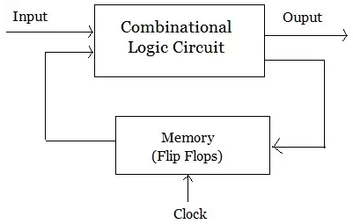
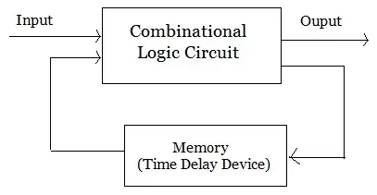
Difference between Synchronous and Asynchronous Sequential Circuits
Synchronous Sequential Circuit
Asynchronous Sequential Circuit
A sequential circuit whose output behavior depends on the input at a discrete-time is called synchronous sequential circuits.
The sequential circuit whose output depends on the sequence in which the input changes are called asynchronous sequential circuits.

Slide 16
Asynchronous sequential circuits are digital circuits that are not driven by clock. They can be called as self-timed circuits.
Output depends on the sequence in which the input changes.
In asynchronous sequential circuits un-clocked memory elements are used like un-clocked flip flop or time delay elements.
Asynchronous sequential circuits are more difficult to describe, analyze and design.
Because of absence of clock pulse, it can be operate faster than synchronous sequential circuits.
In these circuits state change occurs whenever input variable change.
Synchronous sequential circuits are digital circuits governed by clock signals.
Output behavior depends on the input at discrete time.
In synchronous sequential circuits memory elements are used like clocked flip flop.
Synchronous sequential circuits are easier to describe, analyze and design.
Due to the presence of clock pulse the operating speed of synchronous sequential circuits is low.
In these circuits change in state occurs in response to clock pulse.

Slide 17
Storage elements
Storage elements in digital electronics are circuits, primarily latches and flip-flops, that maintain a binary state (0 or 1) until a new input or clock signal directs them to change.
Latches are level-sensitive, changing their state when the input level meets certain criteria.
Flip-Flops are edge-triggered means flip-flop's state changes only at the exact moment a clock pulse transitions (e.g., from low to high).

Slide 18
What is a Latch?
A latch is an asynchronous sequential circuit whose output changes immediately with the change in the applied input.
It can store 1-bit information.
It is used as the fundamental memory element in digital circuits.
A latch can have two stable states namely, set and reset.
The set state is denoted by the logic 1 and the reset state is represented by the logic 0.
Due to these two stable states, a latch is also known as a bistable-multivibrator.

Slide 19
It does not have a clock signal for synchronization. That is why they are called asynchronous sequential circuits.
The latch has two useful states.
  When output Q = 1 and Q’ = 0, the latch is said to be in the set state.
  When Q = 0 and Q’ = 1, it is in the reset state.
Outputs Q and Q’ are normally the complement of each other.

Slide 20
Types of Latches
Latches are divided into the following types in digital circuits;
SR Latch
JK Latch
D Latch
T Latch

Slide 21
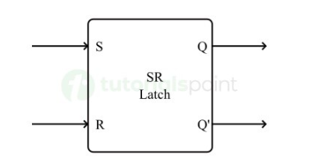
SR Latch
The SR latch is a type of latch which has two input lines designated as S and R.
Where, S represents the Set input and R represents the Reset input. Thus, it is also known as Set-Reset Latch.
The SR latch has two stable states namely Set state (S) and Reset state (R).
The S input sets the output (Q) to 1, while the R input resets the output(Q) to 0.
When S = 1, Q = 1, Set
When R=1, Q=0, Reset
Fig. Block diagram of the SR latch

Slide 22
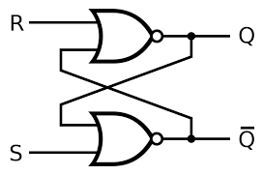
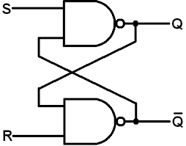
SR Latch
The SR latch is a circuit with two cross-coupled NOR gates or two cross-coupled NAND gates, and two inputs labeled S for set and R for reset.
SR latch with NOR gates
SR latch with NAND gates

Slide 23
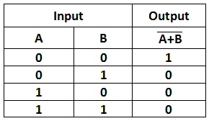

SR latch with NOR gates
$$S R Q \overline{Q}$$
1
0
0 0
0 1
1 0
1 1
1
0 1 Reset
0
Logic diagram
Function table

Slide 24
SR latch with NOR gates
$$S R Q \overline{Q}$$
0
0
0
0 1 No change
0 0
0 1
1 0
1 1
1
0 1 Reset
0
Logic diagram
Function table

Slide 25
SR latch with NOR gates
$$S R Q \overline{Q}$$
0
1
0 1 No change
0 0
0 1
1 0
1 1
0
0 1 Reset
1
1 0 Set
Logic diagram
Function table

Slide 26
SR latch with NOR gates
$$S R Q \overline{Q}$$
0
1
1
0 1 No change
0 0
0 1
1 0
1 1
1 0 No change
0
0 1 Reset
0
1 0 Set
Logic diagram
Function table

Slide 27
SR latch with NOR gates
$$S R Q \overline{Q}$$
1
0
0 1 No change
0 0
0 1
1 0
1 1
1 0 No change
0
0 1 Reset
1
1 0 Set
Logic diagram
0 0 Indeterminate or undefined
Function table

Slide 28
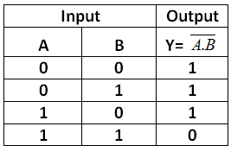
SR latch with NAND gates
0
$$S R Q \overline{Q}$$
1
0 0
0 1
1 0
1 1
1 0 Set
0
1
Logic diagram
Function table

Slide 29
SR latch with NAND gates
1
$$S R Q \overline{Q}$$
1
1
0 0
0 1
1 0
1 1
1 0 Set
0
1
1 0 No change
Logic diagram
Function table

Slide 30
SR latch with NAND gates
1
$$S R Q \overline{Q}$$
0
0 0
0 1
1 0
1 1
1 0 Set
1
0 1 Reset
0
1 0 No change
Logic diagram
Function table

Slide 31
SR latch with NAND gates
1
$$S R Q \overline{Q}$$
0
0
0 0
0 1
1 0
1 1
1 0 Set
1
0 1 Reset
1
1 0 No change
Logic diagram
0 1 No change
Function table

Slide 32
SR latch with NAND gates
0
$$S R Q \overline{Q}$$
1
0 0
0 1
1 0
1 1
1 1 Indeterminate
1 0 Set
1
0 1 Reset
0
1 0 No change
Logic diagram
0 1 No change
Function table

Slide 33
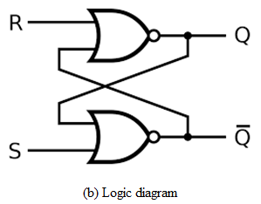
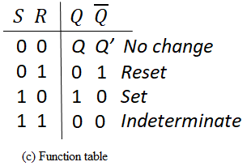
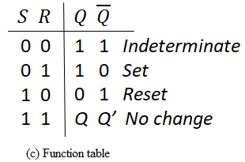
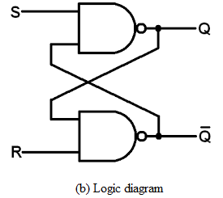
SR latch with NOR gates
Actual case in SR latch
When S = 1, Q = 1, Set
When R=1, Q=0, Reset
SR latch with NAND gates

Slide 34
In comparing the NAND with the NOR latch, note that the input signals for the NAND require the complement of those values used for the NOR latch.
Because the NAND latch requires a 0 signal to change its state, it is sometimes referred to as an S’R’ latch.
SR latch with NOR gates is called Active-high SR Latch because which is SET when S = 1(HIGH).
SR latch with NAND gates is called Active-low SR Latch because which is SET when S = 0(LOW).
Opposite in SR NAND latch
When S = 0, Q = 1, Set
When R=0, Q=0, Reset
Actual case in SR latch
When S = 1, Q = 1, Set
When R=1, Q=0, Reset

Slide 35
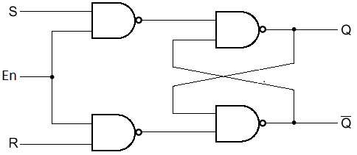
SR latch with control input
The operation of the basic SR latch can be modified by providing an additional input signal that determines (controls) when the state of the latch can be changed by determining whether S and R (or S’ and R’) can affect the circuit.
An SR latch with a control input is shown in Fig.

Slide 36
It consists of the basic SR latch and two additional NAND gates.
The control input En acts as an enable signal for the other two inputs.
The outputs of the NAND gates stay at the logic-1 level as long as the enable signal remains at 0.
This is the quiescent condition for the SR latch.
When the enable input goes to 1, information from the S or R input is allowed to affect the latch.

Slide 37
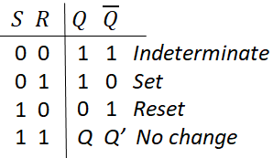

SR latch with control input
1
0
1
Next state of
$$En S R Q \overline{Q}$$
Logic diagram
0 X X
1 0 0
1 0 1
1 1 0
1 1 1
Q Q’ No change
Function table

Slide 38
SR latch with control input
0
1
1
0
1
Next state of
$$En S R Q \overline{Q}$$
Logic diagram
0 X X
1 0 0
1 0 1
1 1 0
1 1 1
Q Q’ No change
Q Q’ No change
Function table

Slide 39
SR latch with control input
0
1
0
1
1
1
0
Next state of
$$En S R Q \overline{Q}$$
Logic diagram
0 X X
1 0 0
1 0 1
1 1 0
1 1 1
Q Q’ No change
Q Q’ No change
0 1 Reset
Function table

Slide 40
SR latch with control input
1
0
1
1
0
0
1
Next state of
$$En S R Q \overline{Q}$$
Logic diagram
0 X X
1 0 0
1 0 1
1 1 0
1 1 1
Q Q’ No change
Q Q’ No change
0 1 Reset
1 0 Set
Function table

Slide 41
SR latch with control input
1
0
1
1
1
1
0
Next state of
$$En S R Q \overline{Q}$$
Logic diagram
0 X X
1 0 0
1 0 1
1 1 0
1 1 1
Q Q’ No change
Q Q’ No change
0 1 Reset
1 0 Set
1 1 Indeterminate
Function table

Slide 42
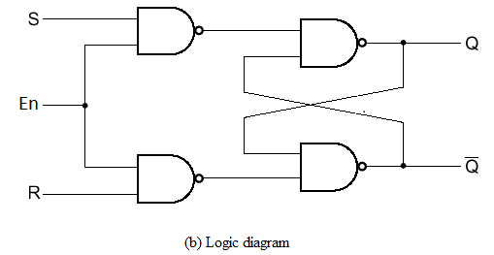
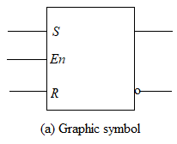
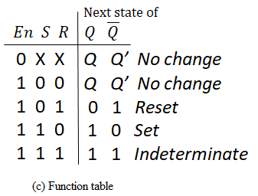
SR latch with control input

Slide 43
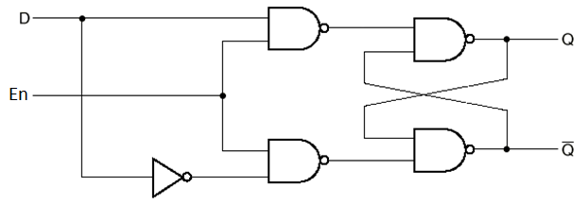
D Latch (Transparent Latch)
One way to eliminate the undesirable condition of the indeterminate state in the SR latch is to ensure that inputs S and R are never equal to 1 at the same time.
This is done in the D latch, shown in Fig.

Slide 44
This latch has only two inputs: D (data) and En (enable).
The D input goes directly to the S input, and its complement is applied to the R input.
As long as the enable input is at 0, the cross-coupled SR latch has both inputs at the 1 level and the circuit cannot change state regardless of the value of D .
The D input is sampled when En = 1.
  If D = 1, the Q output goes to 1, placing the circuit in the set state.
  If D = 0, output Q goes to 0, placing the circuit in the reset state.

Slide 45
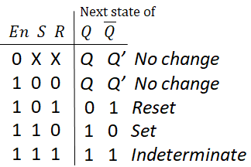

D Latch
0
Logic diagram
Next state of
$$En D Q \overline{Q}$$
0 X
1 0
1 1
Q Q’ No change
Function table

Slide 46
D Latch
0
0
0
1
1
1
Logic diagram
Next state of
$$En D Q \overline{Q}$$
0 X
1 0
1 1
Q Q’ No change
0 1 Reset
Function table

Slide 47
D Latch
1
1
1
1
0
0
Next state of
Logic diagram
$$En D Q \overline{Q}$$
0 X
1 0
1 1
Q Q’ No change
0 1 Reset
1 0 Set
Function table

Slide 48
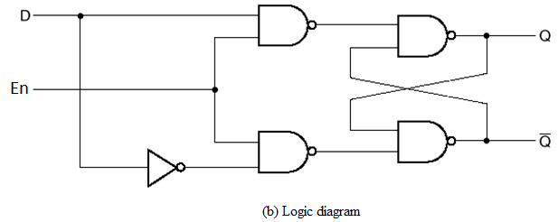
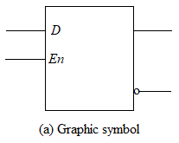
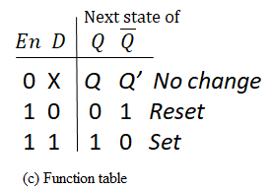
D latch

Slide 49
The D latch receives that designation from its ability to hold data in its internal storage.
It is suited for use as a temporary storage for binary information between a unit and its environment.
The binary information present at the data input of the D latch is transferred to the Q output when the enable input is asserted. The output follows changes in the data input as long as the enable input is asserted.
This situation provides a path from input D to the output, and for this reason, the circuit is often called a transparent latch.

Slide 50
FLIP-FLOPS
The storage elements (memory) used in clocked sequential circuits are called flip-flops.
A flip-flop is a binary storage device capable of storing one bit of information.
In a stable state, the output of a flip-flop is either 0 or 1.
A sequential circuit may use many flip-flops to store as many bits as necessary.

Slide 51
Difference between Flip-flop and Latch
Flip-flop
Latch
Flip-flop is a bistable device i.e., it has two stable states that are represented as 0 and 1.
It checks the inputs but changes the output only at times defined by the clock signal.
It is an edge triggered device.
Flip-flops are designed with latches by adding an extra clock signal.
Flip-flop always have a clock signal.
A flip-flop can be clocked for all time.
Flip-Flops are very slow and consume more power.
Latch is also a bistable device whose states are also represented as 0 and 1.
It checks the inputs continuously and responds to the changes in inputs immediately.
It is a level triggered device.
The structure of latch is built with logic gates.
Latch doesn’t have a clock signal.
A latch may be clock less or clocked.
Latches are very fast and consume less power.

Slide 52
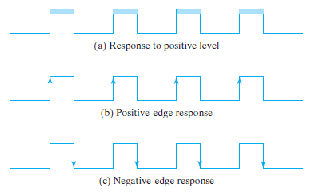
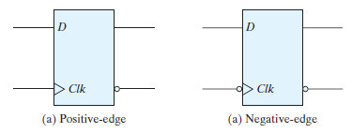
Clock response in latch and flip-flop

Slide 53
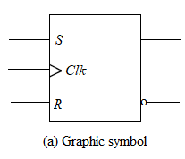
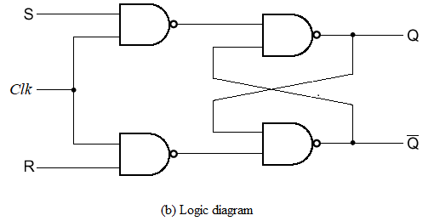
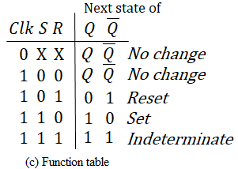
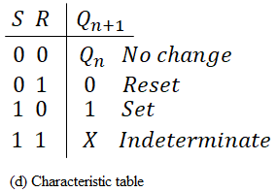
SR Flip-Flop

Slide 54
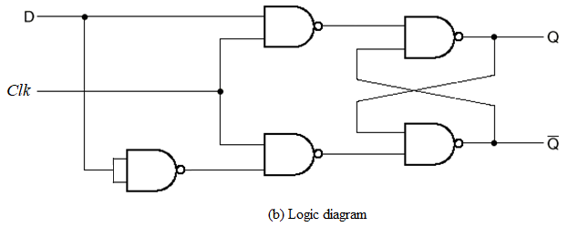
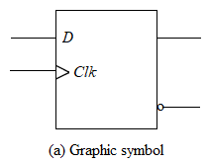
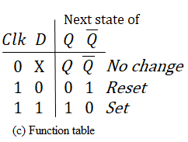
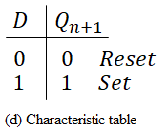
D Flip-Flop

Slide 55
JK Flip-Flop
There are three operations that can be performed with a flip-flop: set it to 1, reset it to 0, or complement its output.
With only a single input, the D flip-flop can set or reset the output, depending on the value of the D input immediately before the clock transition.
Synchronized by a clock signal, the JK flip-flop has two inputs and performs all three operations.
The circuit diagram of a JK flip-flop constructed with a SR flip-flop and gates is shown in Fig.

Slide 56
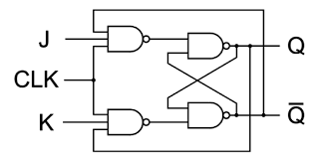
The two-input NAND gates of the RS flip-flop is replaced by the two 3 inputs NAND gates with the third input of each gate connected to the outputs at Q and Ǭ.
The J input sets the flip-flop to 1, the K input resets it to 0, and when both inputs are enabled, the output is complemented.

Slide 57

JK Flip-Flop
1
0
Next state of
1
$$Clk J K Q \overline{Q} Q \overline{Q}$$
0 X X
1 0 0
1 0 1
1 1 0
1 1 1
0 1
1 0
0 1
1 0
0 1
1 0
Q Q’ No change
Logic diagram
Function table

Slide 58
JK Flip-Flop
1
0
1
0
Next state of
1
$$Clk J K Q \overline{Q} Q \overline{Q}$$
0 X X
1 0 0
1 0 1
1 1 0
1 1 1
0 1
1 0
0 1
1 0
0 1
1 0
Q Q’ No change
Logic diagram
Q Q’ No change
Function table

Slide 59
JK Flip-Flop
1
0
0
0
1
1
1
1
Next state of
1
$$Clk J K Q \overline{Q} Q \overline{Q}$$
0 X X
1 0 0
1 0 1
1 1 0
1 1 1
0 1
1 0
0 1
1 0
0 1
1 0
Q Q’ No change
Logic diagram
Q Q’ No change
0 1
Function table

Slide 60
JK Flip-Flop
1
0
1
0
1
1
0
1
Next state of
0
$$Clk J K Q \overline{Q} Q \overline{Q}$$
0 X X
1 0 0
1 0 1
1 1 0
1 1 1
0 1
1 0
0 1
1 0
0 1
1 0
Q Q’ No change
Logic diagram
Q Q’ No change
0 1
0 1 Reset
Function table

Slide 61
JK Flip-Flop
0
1
0
1
1
0
1
0
Next state of
1
$$Clk J K Q \overline{Q} Q \overline{Q}$$
0 X X
1 0 0
1 0 1
1 1 0
1 1 1
0 1
1 0
0 1
1 0
0 1
1 0
Q Q’ No change
Logic diagram
Q Q’ No change
0 1
0 1 Reset
1 0
Function table

Slide 62
JK Flip-Flop
1
1
1
1
1
0
0
0
Next state of
1
$$Clk J K Q \overline{Q} Q \overline{Q}$$
0 X X
1 0 0
1 0 1
1 1 0
1 1 1
0 1
1 0
0 1
1 0
0 1
1 0
Q Q’ No change
Logic diagram
Q Q’ No change
0 1
0 1 Reset
1 0
1 0 Set
Function table

Slide 63
JK Flip-Flop
0
1
0
1
1
1
1
0
Next state of
1
$$Clk J K Q \overline{Q} Q \overline{Q}$$
0 X X
1 0 0
1 0 1
1 1 0
1 1 1
0 1
1 0
0 1
1 0
0 1
1 0
Q Q’ No change
Logic diagram
Q Q’ No change
0 1
0 1 Reset
1 0
1 0 Set
1 0
Function table

Slide 64
JK Flip-Flop
1
1
1
0
1
1
0
1
Next state of
0
$$Clk J K Q \overline{Q} Q \overline{Q}$$
0 X X
1 0 0
1 0 1
1 1 0
1 1 1
0 1
1 0
0 1
1 0
0 1
1 0
Q Q’ No change
Logic diagram
Q Q’ No change
0 1
0 1 Reset
1 0
1 0 Set
1 0
0 1 Complement
Function table

Slide 65
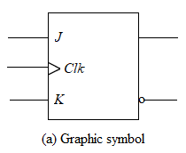
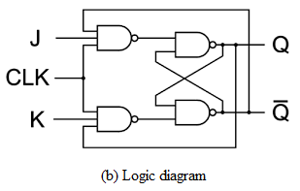
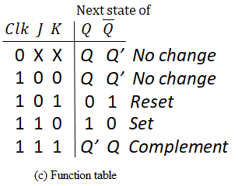
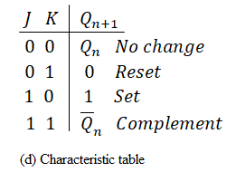
JK Flip-Flop

Slide 66
T Flip-Flop
The T (toggle) flip-flop is a complementing flip-flop and can be obtained from a JK flip-flop when inputs J and K are tied together.
When T = 0 (J = K = 0), a clock edge does not change the output.
When T = 1 (J = K = 1), a clock edge complements the output.
The complementing flip-flop is useful for designing binary counters.

Slide 67
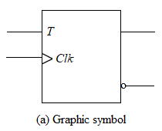
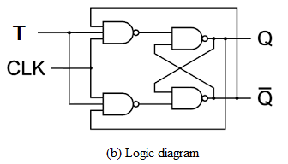
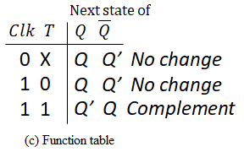
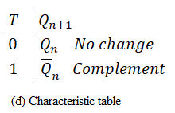
T Flip-Flop

Slide 68
Direct Inputs
Some flip-flops have the direct inputs (Asynchronous inputs) in Flip-Flop that is used to initialize the internal state to a known value.
These inputs are called the preset (PRE) and clear (CLR).
These inputs are used to set the start condition of the flip-flop - CLR sets Q to 0; PR sets Q to 1.
The input that sets the flip-flop to 1 is called preset or direct set.
The input that clears the flip-flop to 0 is called clear or direct reset.
When power is turned on in a digital system, the state of the flip-flops is unknown. The direct inputs are useful for bringing all flip-flops in the system to a known starting state prior to the clocked operation.

Slide 69
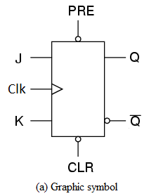
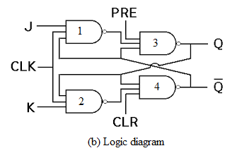

Slide 70
If PRE = 0 and CLR = 1, the output of NAND gate 3 is forced to be 1, i.e., Q = 1 and the flip-flop is set, overwriting the previous state of the flip-flop.
If PRE = 1 and CLR = 0, the output of NAND gate 4 is forced to be 1, i.e., Q' = 1 and the flip-flop is reset, overwriting the previous state of the flip-flop.
Once the state of the flip-flop is established asynchronously, the inputs PRE and CLR must be connected to logic 1 before the next clock is applied.
The condition PRE = CLR = 0 must not be applied, since this leads to an uncertain state.

Slide 71
Race Around Condition
For JK flip-flop, if J = K = 1, and if Clk = 1 for a long period of time, then Q output will toggle as long as Clk is high, which makes the output of the flip-flop unstable or uncertain. This problem is called race around condition in JK flip-flop.
There are three methods to eliminate race around condition as described below:

Slide 72
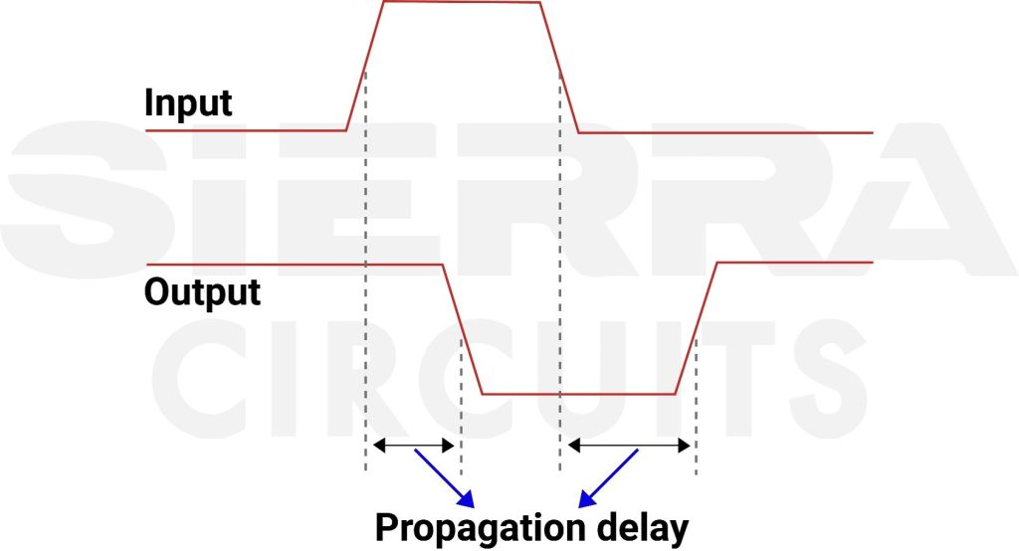
Increasing the delay of flip-flop
  The propagation delay (Δt) should be made greater than the duration of the clock pulse (T). But it is not a good solution as increasing the delay will decrease the speed of the system.
Use of edge-triggered flip-flop
  If the clock is High for a time interval less than the propagation delay of the flip-flop then racing around condition can be eliminated. This is done by using the edge-triggered flip-flop rather than using the level-triggered flip-flop.
Use of Master-Slave JK flip-flop
  If the flip-flop is made to toggle over one clock period then racing around condition can be eliminated. This is done by using Master-Slave JK flip-flop.

Slide 73
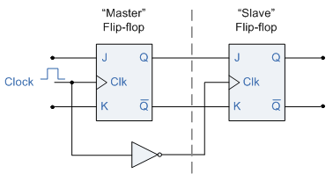
Master-Slave JK Flip-flop
Master-Slave flip-flop are the cascaded combination of two flip-flops among which the first is designated as master flip-flop while the next is called slave flip-flop.

Slide 74
Here the master flip-flop is triggered by the external clock pulse train while the slave is activated at its inversion i.e. if the master is positive edge-triggered, then the slave is negative edge-triggered and vice-versa.
This means that the data enters into the flip-flop at leading/trailing edge of the clock pulse while it is obtained at the output pins during trailing/leading edge of the clock pulse.

Slide 75
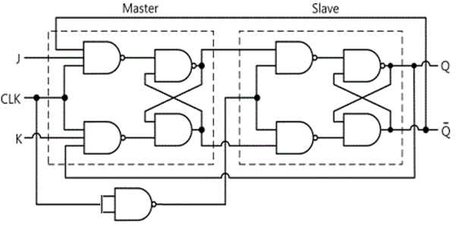
Q_{m}
Q'_{m}
The Master-Slave flip-flop is basically two flip-flops connected together in a series configuration, with the slave having an inverted clock pulse.

Slide 76
The outputs from Q and Q’ from the “Slave” flip-flop are fed back to the inputs of the “Master” with the outputs of the “Master” flip-flop being connected to the two inputs of the “Slave” flip-flop.
This feedback configuration from the slave’s output to the master’s input gives the characteristic toggle of the JK flip-flop as shown below.
When Clk is HIGH, the first flip-flop (i.e., the master) is enabled and the outputs Q_{m} and Q'_{m} respond to the inputs J and K according to the characteristic table. At this time the second flip-flop (i.e., the slave) is disabled because the Clk is LOW to the second flip-flop.

Slide 77
Similarly, when Clk becomes LOW, the master becomes disabled and the slave becomes active, since now the Clk to it is HIGH. Therefore, the outputs Q and Q' follow the outputs Q_{m} and Q'_{m} respectively.
Since the second flip-flop just follows the first one, it is referred to as a slave and the first one is called the master.

